Slide 1
JUPYTERLAB EXTENSIONS
© 2020 IBM Corporation

Slide 2
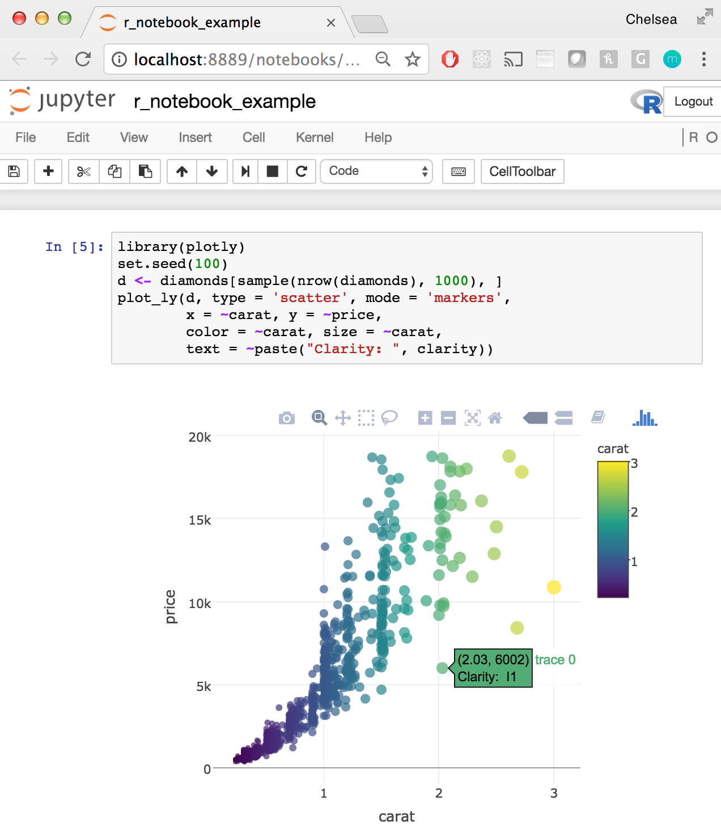
What is JupyterLab?
Started from classic Jupyter Notebook, a web-based interface that can execute code, edit in-place, contain text, images, etc.
Notebooks presents a document-like view rendered by modern bowsers
Kernels interpret/execute cell contents with support for over 50 programming languages
Classic Notebook:
What is JupyterLab
What are JupyterLab Extensions
Why use JupyterLab Extensions
Installing Extensions
Creating an Extension
© 2020 IBM Corporation
Notes:
Run notebook command: jupyter notebook

Slide 3
What is JupyterLab?
JupyterLab is the next generation UI for Project Jupyter
It provides a modular and extensible architecture
It will eventually replace the classic Jupyter Notebook UI
JupyterLab:
What is JupyterLab
What are JupyterLab Extensions
Why use JupyterLab Extensions
Installing Extensions
Creating an Extension
Console/Terminal
Tabbed Workspaces
File Explorer
Split screen
© 2020 IBM Corporation
Notes:
Run JupyterLab command: jupyter lab

Slide 4
What is JupyterLab?
On JupyterLab Org Github :
What is JupyterLab
What are JupyterLab Extensions
Why use JupyterLab Extensions
Installing Extensions
Creating an Extension
JupyterLab and core extensions
JupyterLab extension repos
© 2020 IBM Corporation
Notes:
https://github.com/jupyterlab

Slide 5
What is JupyterLab?
On JupyterLab Github :
What is JupyterLab
What are JupyterLab Extensions
Why use JupyterLab Extensions
Installing Extensions
Creating an Extension
Core extensions:
Application
Utils
Code editor
Notebook
etc
Backend code:
Handlers
Commands
Debug
Extension setup
etc
© 2020 IBM Corporation
Notes:
https://github.com/jupyterlab/jupyterlab

Slide 6
What are JupyterLab Extensions
What is JupyterLab
What are JupyterLab Extensions
Why use JupyterLab Extensions
Installing Extensions
Creating an Extension
JupyterLab is designed to be extendable
Extensions enable users and developers to:
Create new editors and output visualization
Add buttons and menu items to existing functionality
Provide APIs for other extensions to use
JupyterLab itself is just a collection of core extensions
© 2020 IBM Corporation

Slide 7
Why use JupyterLab Extensions
What is JupyterLab
What are JupyterLab Extensions
Why use JupyterLab Extensions
Installing Extensions
Creating an Extension
The core extensions are intentionally limited in scope
Every user needs slightly different tools for their own work
By installing extensions specific to their scenario they can create a customized environment tailored to their work
© 2020 IBM Corporation
Notes:
When should you create JupyterLab extensions?
Whenever the extension you want doesn’t exist!

Slide 8
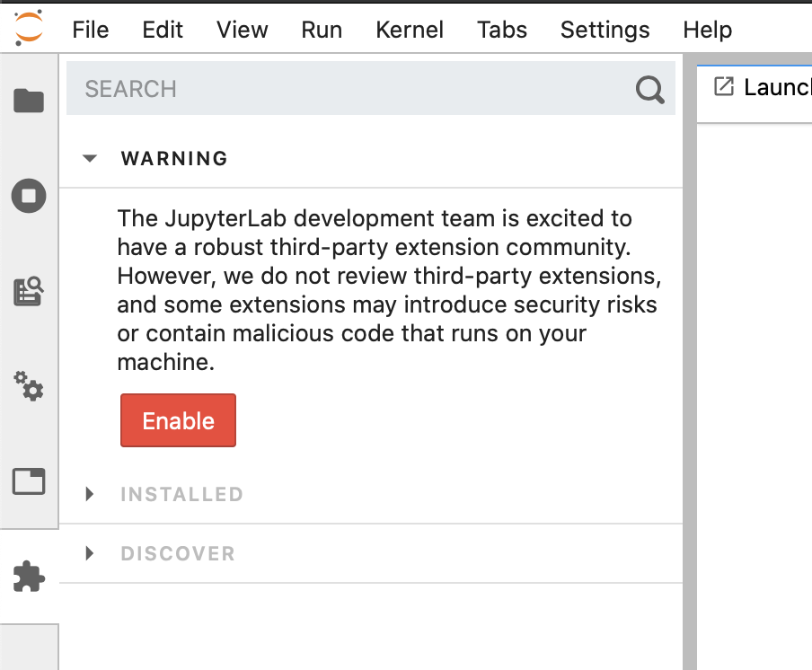
Installing Extensions
What is JupyterLab
What are JupyterLab Extensions
Why use JupyterLab Extensions
Installing Extensions
Creating an Extension
Start JupyterLab
$ jupyter lab
To install an extension via the UI open the Extension Manager tab in the side bar
The UI is still experimental and will show a warning prior to enablement
Once enabled it will list currently installed extensions in the Installed section and extensions available to install in the Discover tab.
You can search both sections using the search bar
The Discover tab displays packages published on npm with the keywork ‘jupyterlab-extension’
© 2020 IBM Corporation

Slide 9
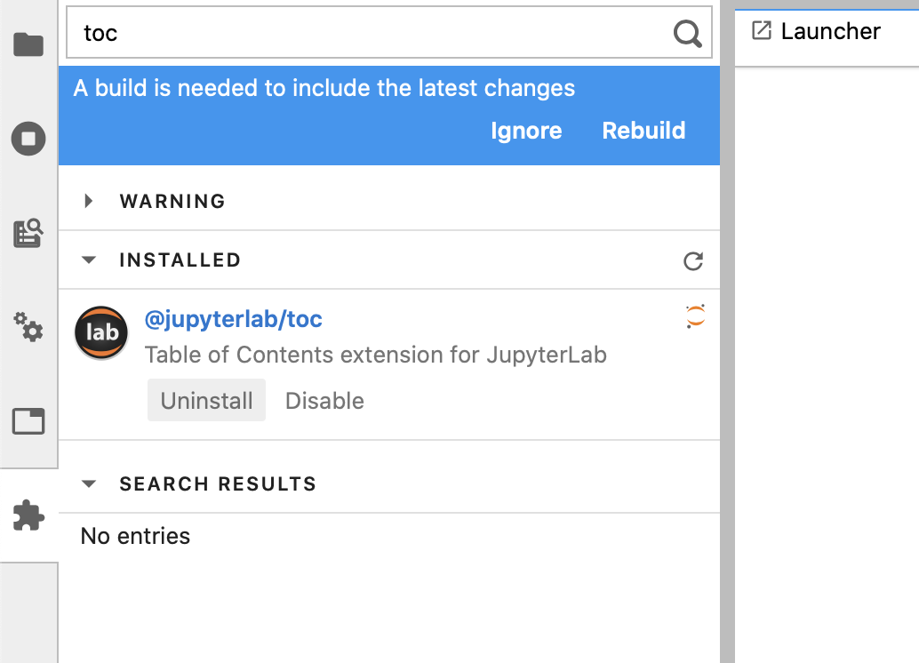
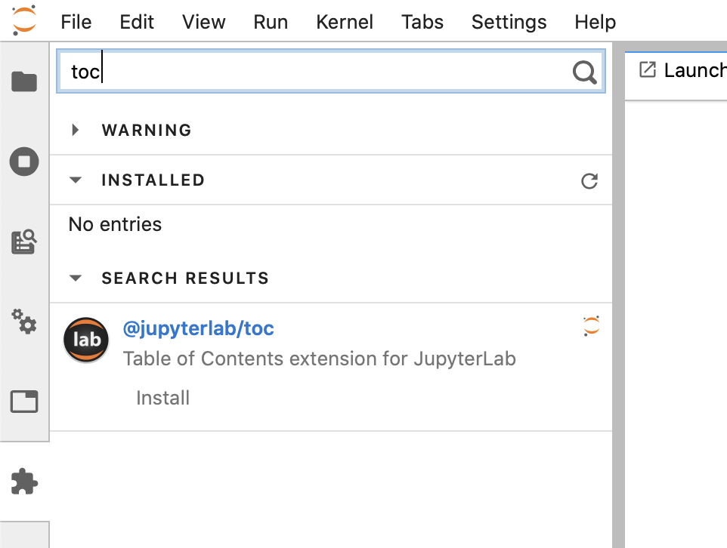
Installing Extensions
What is JupyterLab
What are JupyterLab Extensions
Why use JupyterLab Extensions
Installing Extensions
Creating an Extension
In the search bar, search for ”toc” and click Install
After installing it will prompt you to rebuild jupyterlab
© 2020 IBM Corporation

Slide 10
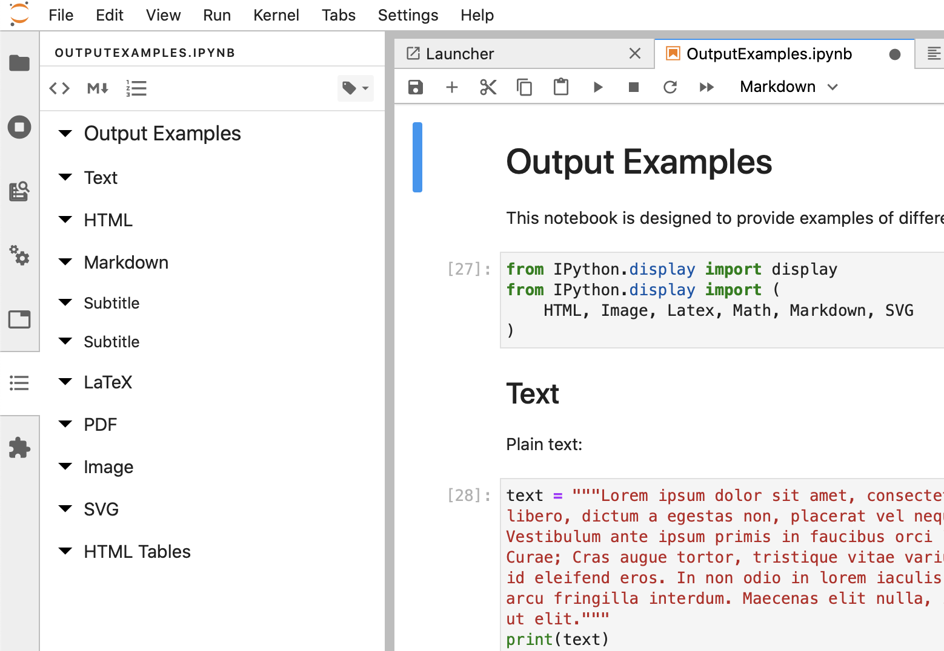
Installing Extensions
What is JupyterLab
What are JupyterLab Extensions
Why use JupyterLab Extensions
Installing Extensions
Creating an Extension
Once it finishes installing it will prompt you to refresh
After refreshing you will see the new TOC tab in your sidebar, try opening the TOC tab while a notebook, markdown, or python file is open
© 2020 IBM Corporation

Slide 11
Installing Extensions
What is JupyterLab
What are JupyterLab Extensions
Why use JupyterLab Extensions
Installing Extensions
Creating an Extension
Some extensions can’t be installed via the UI. Try searching for and installing ”git”. It will display a message telling you that the extension requires requires a corresponding server extension.
For server extensions we need to install via the CLI
Go back to your terminal and (double) ctrl-C lab
Then install the git extension:
$ pip install jupyterlab-git
$ jupyter lab build
This will install both the lab extension and the server extension. Once it’s finished start JupyterLab again:
$ jupyter lab
Definitions:
labextension – front end extensions; can be installed and built via UI without restarting JupyterLab
serverextension – back end extensions; must be installed via CLI and require restarting JupyterLab
© 2020 IBM Corporation

Slide 12
Creating an Extension
What is JupyterLab
What are JupyterLab Extensions
Why use JupyterLab Extensions
Installing Extensions
Creating an Extension
Creating a new extension using the cookie-cutter
$ pip install cookiecutter
$ cookiecutter https://github.com/jupyterlab/extension-cookiecutter-ts
Customizing your extension (following the guide on the next slide)
Installing your extension (following the generated README)
Running JupyterLab with your extension
© 2020 IBM Corporation

Slide 13
Creating an Extension A few quick steps to an example custom extension
What is JupyterLab
What are JupyterLab Extensions
Why use JupyterLab Extensions
Installing Extensions
Creating an Extension
Add these dependencies to package.json
"@jupyterlab/apputils": "^2.0.0",
"@jupyterlab/docregistry": "^2.0.0",
"@jupyterlab/notebook": "^2.0.0",
"@lumino/disposable": ”^1.3.5”
Copy the file in this gist to src and import it in index.ts
https://gist.github.com/ajbozarth/48f0fe7f4213e11dc487046b73ded8f8
import {ButtonExtension} from "./button";
Add this code to the activate function in index.ts
let buttonExtension = new ButtonExtension();
app.docRegistry.addWidgetExtension('Notebook', buttonExtension);
© 2020 IBM Corporation

Slide 14
Useful Links
What is JupyterLab
What are JupyterLab Extensions
Why use JupyterLab Extensions
Installing Extensions
Creating an Extension
JupyterLab Docs: https://jupyterlab.readthedocs.io/
Extension cookie-cutter: https://github.com/jupyterlab/extension-cookiecutter-ts
PyData Berlin Talk (about specific extensions): https://github.com/jtpio/a-tour-of-jupyterlab-extensions
GitHub Topics filter for finding extensions: https://github.com/topics/jupyterlab-extension
Gist with the demo button extension: https://gist.github.com/ajbozarth/48f0fe7f4213e11dc487046b73ded8f8
© 2020 IBM Corporation

